Slide 2
 | 8 |  | 1
7 |  |  |  | 2
6 |  |  |  | 3
 | 5 |  | 4

Slide 3
 | ● |  | ●
● |  |  |  | ●
● |  |  |  | ●
 | ● |  | ●

Slide 4
 |  |  | ●
 |  | ●
 |  | ●
 |  |  | ●
 |  | ●
 |  |  | ●

Slide 5
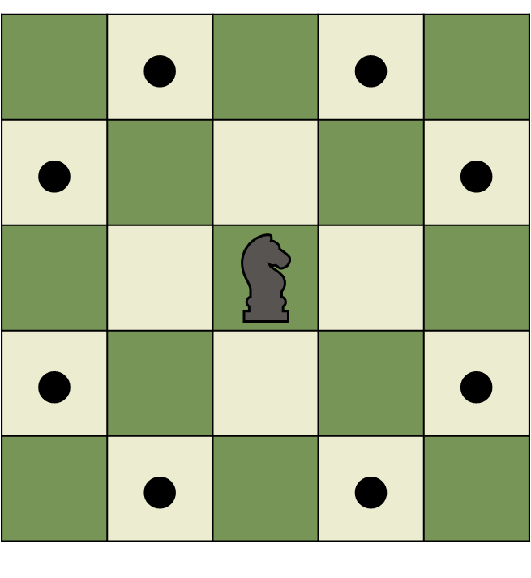
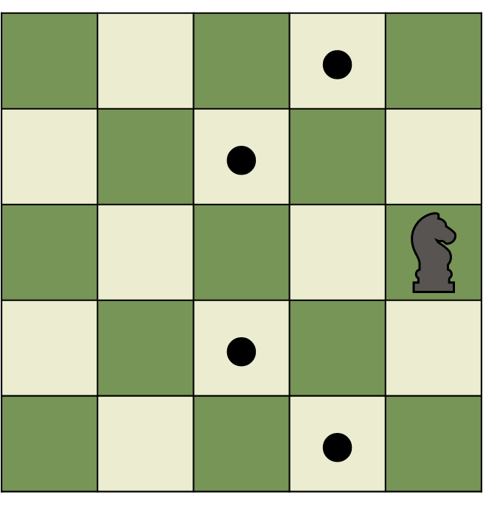
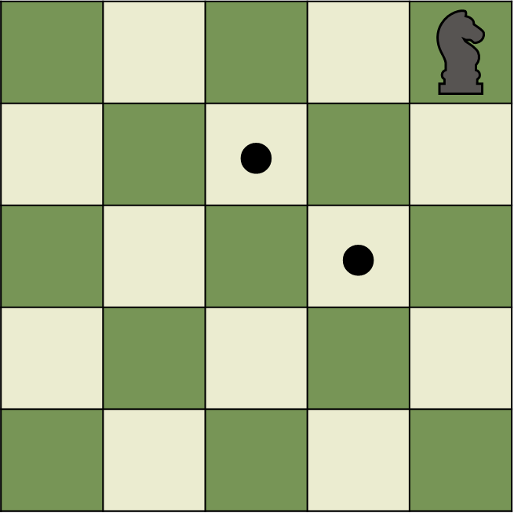

Slide 6
1
2
3
1
S2
2
3
4
S1

Slide 7
 | 8 |  | 1
7 |  |  |  | 2
6 |  |  |  | 3
 | 5 |  | 4
 |  |  | X
 |  | 3
 |  | X
 |  | 2
 |  |  | 1
 |  | 2
 |  | X
 |  |  | 1

Slide 8
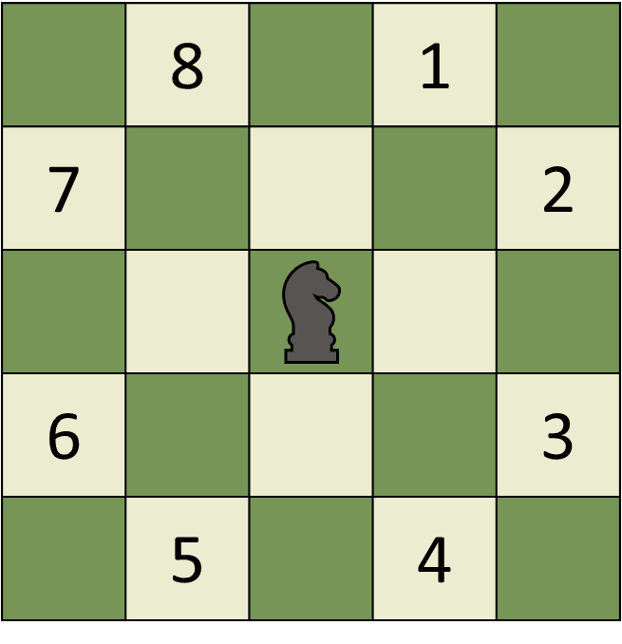
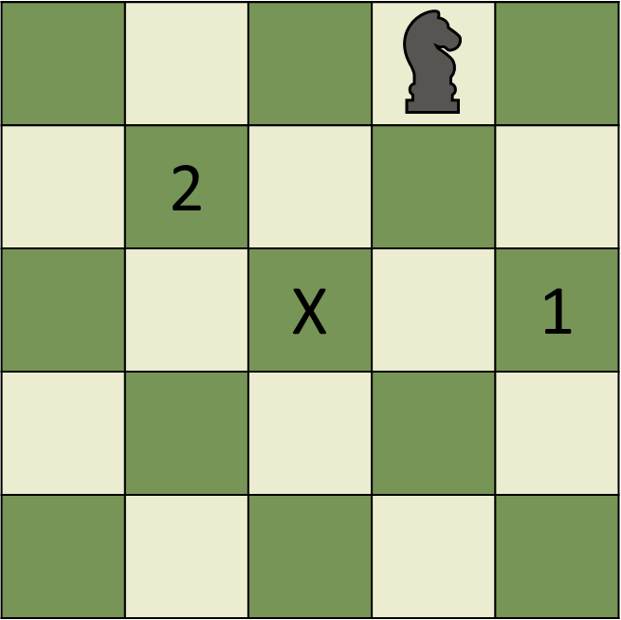
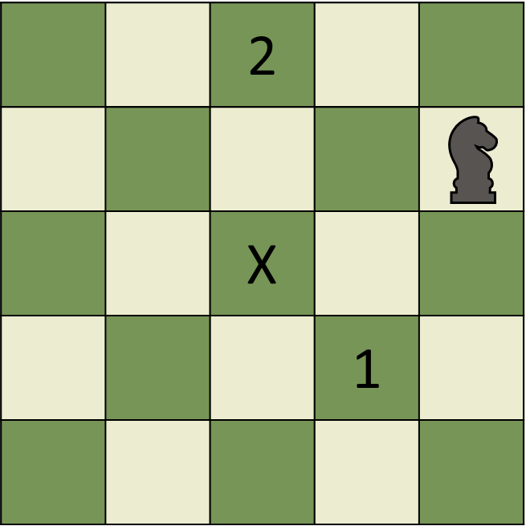
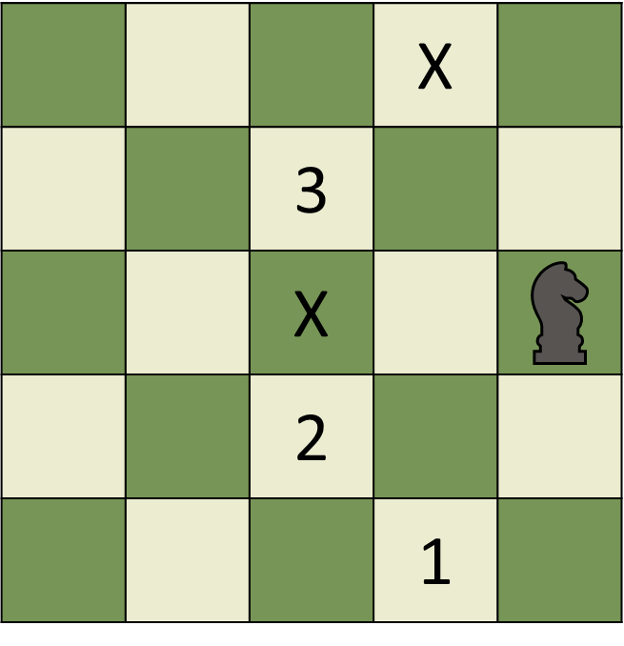
...

Slide 9
(0,0) | (1,0) | (2,0) | (3,0) | (4,0)
(0,1) | (1,1) | (2,1) | (3,1) | (4,1)
(0,2) | (1,2) | (2,2) | (3,2) | (4,2)
(0,3) | (1,3) | (2,3) | (3,3) | (4,3)
(0,4) | (1,4) | (2,4) | (3,4) | (4,4)

Slide 10
 | 2
 | 5
 |  | 5 |  | 2

Slide 11
● | X | X | X | X
X | X | X | X | X
X |  | X | X | X
X | X | X | X | X
X | X | X | X | X

